Slide 1
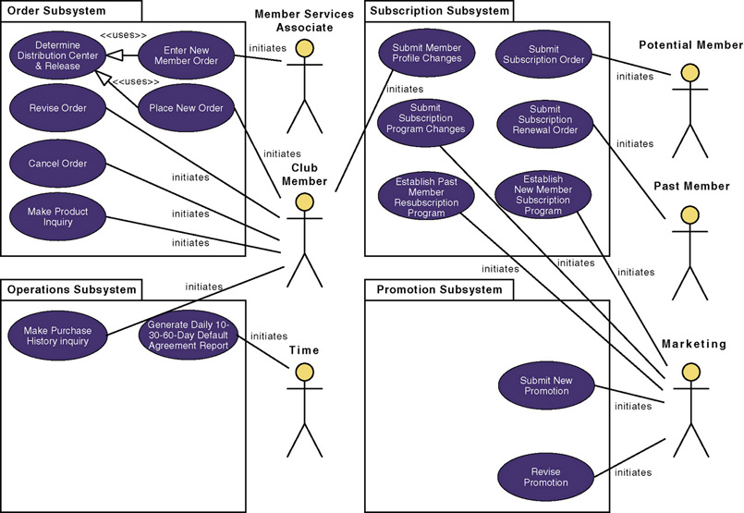
Revised System
Use-Case Model Diagram
10-<number>
Notes:
Teaching Notes
A use case model diagram can be used to graphically depict the system scope and boundaries in terms of use cases and actors.
The use case model diagram for the Member Services System is shown in the above figure. It was created using Popkin Software’s System Architect and represents the relationships between the actors and use cases defined for each business subsystem.
The subsystems (UML package symbol) represent logical functional areas of business processes.
The partitioning of system behavior into subsystems is very important in understanding the system architecture and is very key to defining your development strategy — which use cases will be developed first and by whom.

Slide 2
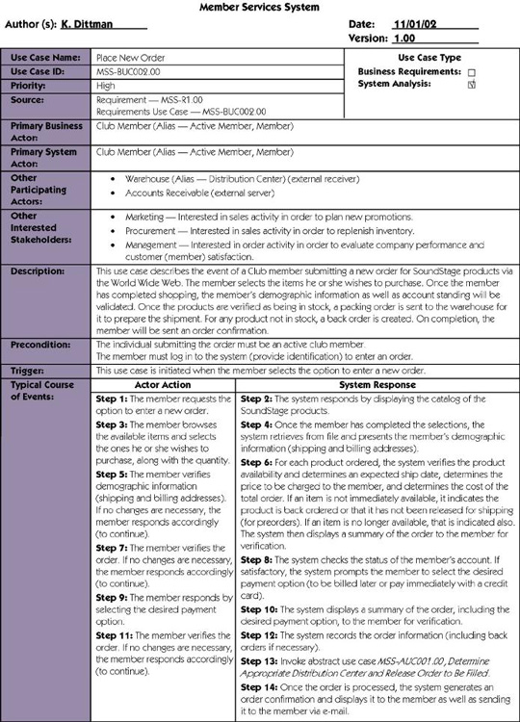
Use-Case Narrative
10-<number>
Notes:
Teaching Notes
If Chapter 7 was covered, this will be review

Slide 3
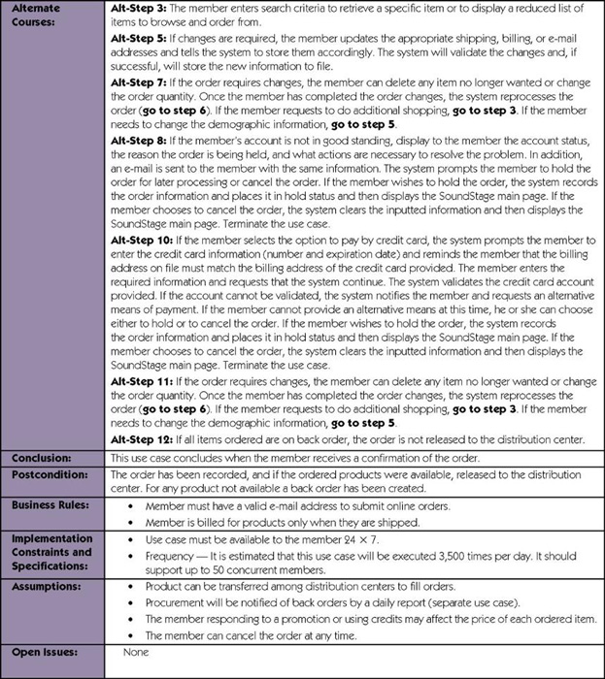
Use-Case Narrative (cont.)
10-<number>
Notes:
Teaching Notes
If Chapter 7 was covered, this will be review

Slide 4
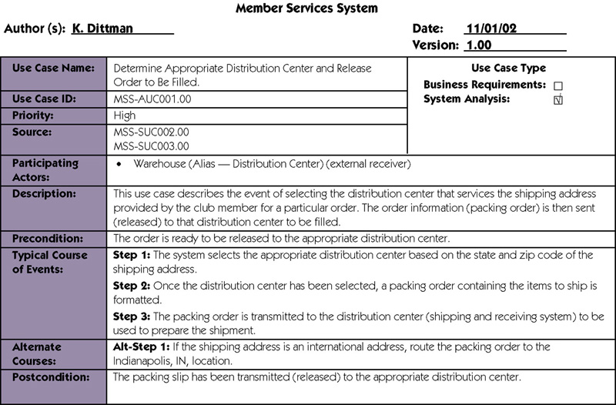
Abstract Use-Case Narrative
10-<number>
Notes:
No additional notes.

Slide 5
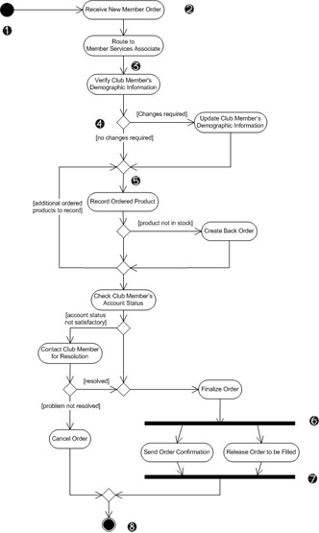
Modeling Use-Case Activities
Activity diagram – a diagram that can be used to graphically depict the flow of a business process, the steps of a use case, or the logic of an object behavior (method).
10-<number>
Notes:
Conversion Notes
In UML 2.0 the activity diagram renames some symbols and uses them more formally.

Slide 6
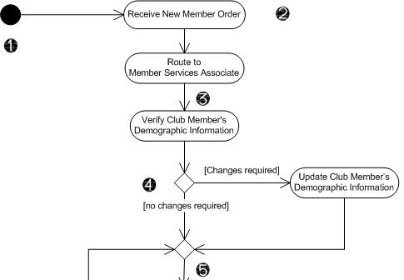
Activity Diagram Notations
Initial node - solid circle
representing the start
of the process.
Actions – rounded
rectangles representing
individual steps. The
sequence of actions
make up the total activity
shown by the diagram.
Flow - arrows on the
diagram indicating the
progression through the
actions. Most flows do not
need words to identify them unless coming out of decisions.
Decision - diamond shapes with one flow coming in and two or more flows going out. The flows coming out are marked to indicate the conditions.
Merge - diamond shapes with multiple flows coming in and one flow going out. This combines flows previously separated by decisions. Processing continues with any one flow coming into the merge.
10-<number>
Notes:
Conversion Notes
This slide has been extensively revised for the seventh edition to correspond with UML 2.0 notation.

Slide 7
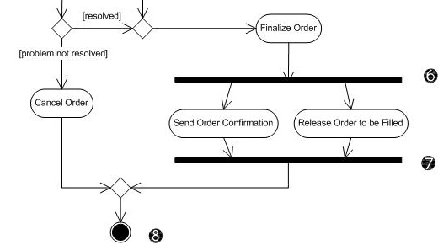
Activity Diagram Notations (cont.)
Fork – a black bar
with one flow
coming in and two
or more flows going
out. Actions on
parallel flows
beneath the fork
can occur in any
order or
concurrently.
Join – a black bar with two or more flows coming in and one flow going out, noting the end of concurrent processing. All actions coming into the join must be completed before processing continues.
Activity final – the solid circle inside the hollow circle representing the end of the process.
10-<number>
Notes:
Conversion Notes
This slide has been extensively revised for the seventh edition to correspond with UML 2.0 notation.

Slide 8
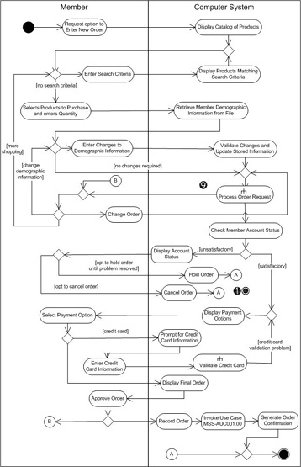
Activity Diagram with Partitions
Subactivity indicator – the rake symbol in an action indicates that this action is broken out in another separate activity diagram. This helps you keep the activity diagram from becoming overly complex.
Connector – A letter inside a circle gives you another tool for managing complexity. A flow coming into a connector jumps to the flow coming out of a connector with a matching letter.
10-<number>
Notes:
Conversion Notes
This slide has been extensively revised for the seventh edition to correspond with UML 2.0 notation.
Teaching Notes
In addition to the subactivity indicator and the connector, this activity diagram shows partitions (formerly swmlanes). Partitions are especially useful when including receiver actors.

Slide 9
Guidelines for Constructing
Activity Diagrams
Start with one initial node as a starting point.
Add partitions if it is relevant to your analysis.
Add an action for each major step of the use case (or each major step an actor initiates.
Add flows from each action to another action, a decision point, or an end point. For maximum precision of meaning, each action should have only one flow coming in and one flow going out with all forks, joins, decisions, and merges shown explicitly.
Add decisions where flows diverge with alternating routes. Be sure to bring them back together with a merge.
Add forks and joins where activities are performed in parallel.
End with a single notation for activity final.
10-<number>
Notes:
Conversion Notes
This is a new slide for the seventh edition.

